Slide 1
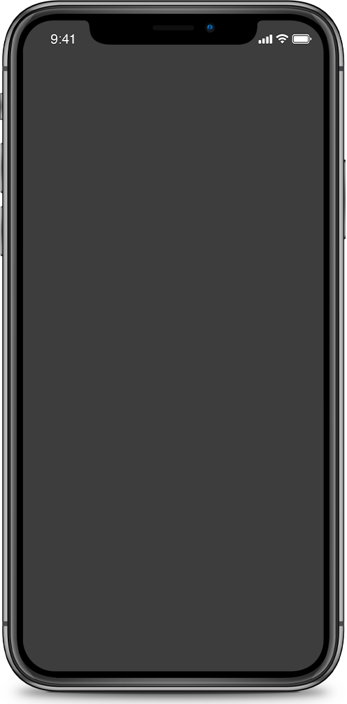
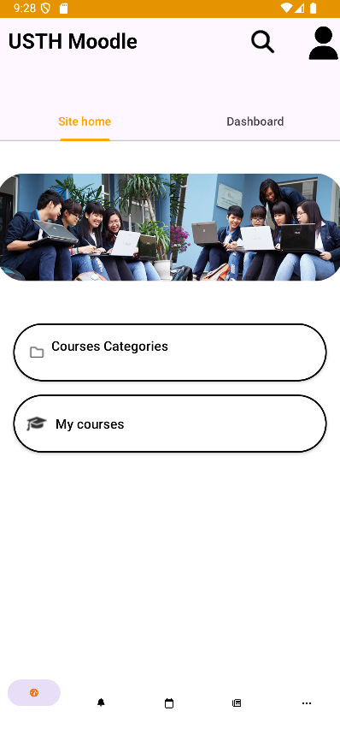
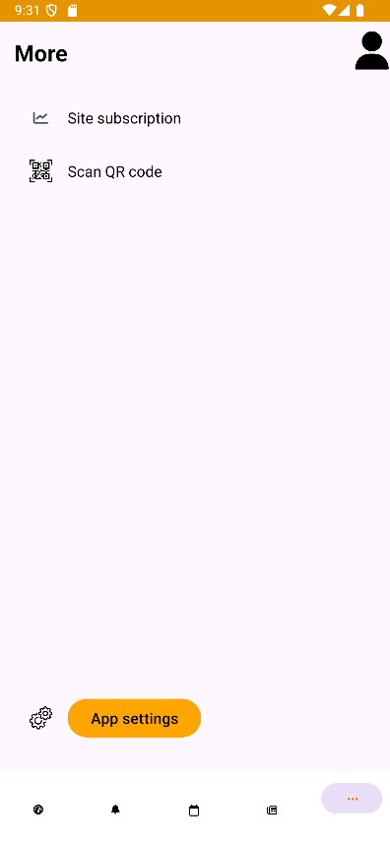

Moodle Client UI
Class 1 - Group 12

Slide 2

Table Content
Introduction
Architecture
Activities
Conclusion
Demo

Slide 3






1. Introduction
Objective: to replicate the UI of the Moodle app - a learning management system
Scope of project: the UI of the Homepage, Notifications, Calender, Site blog, More, Settings and User tab
Key technologies/ tools: Android Studio, GitHub, Java

Slide 4
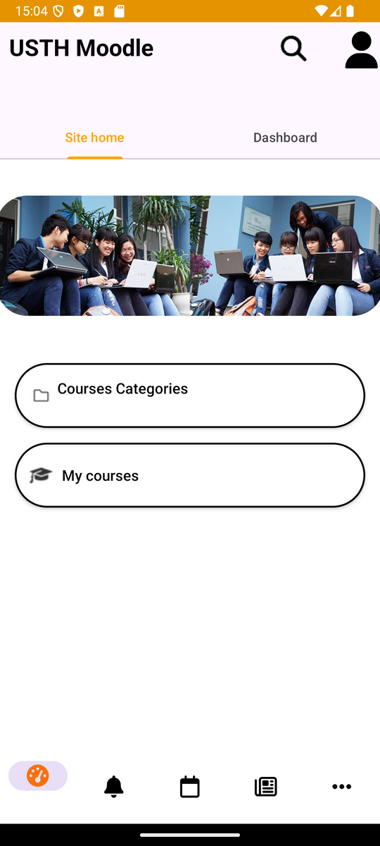

2. Architecture
1) UI layer overview:
different Activities and Fragments define different tabs
visual structures of the UI is designed using Android’s XML files

Slide 5
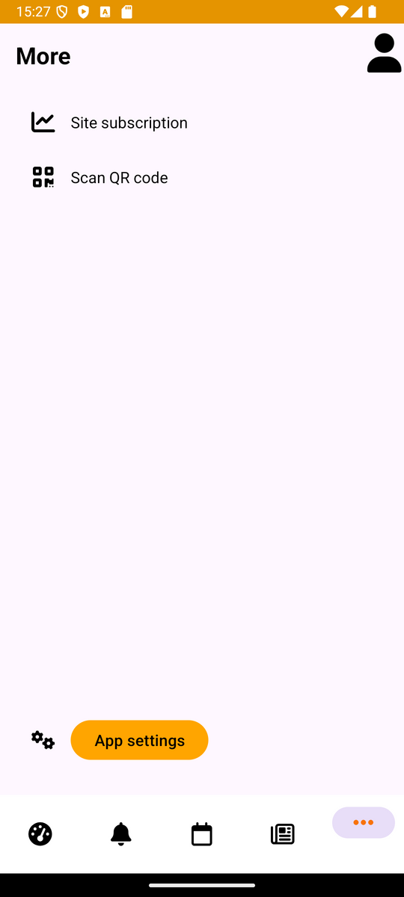
2. Architecture
2) Component reusibility:
reuse custom UI components (icons, buttons, headers,...) to maintain consistency
reuse different fragments

Slide 6
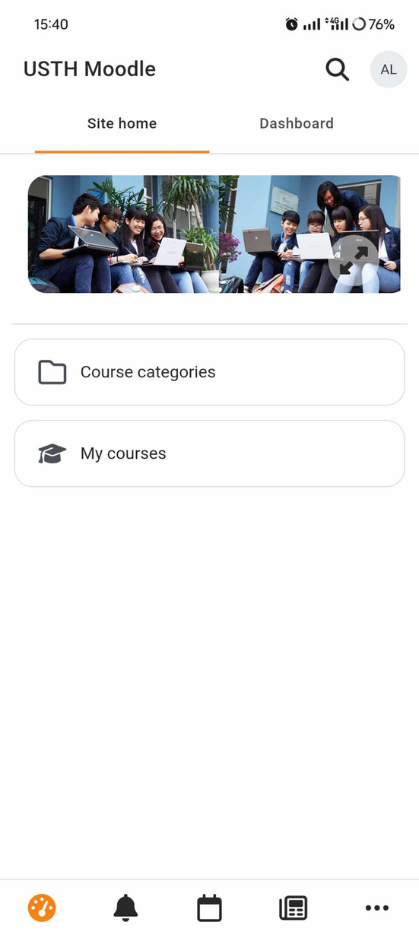
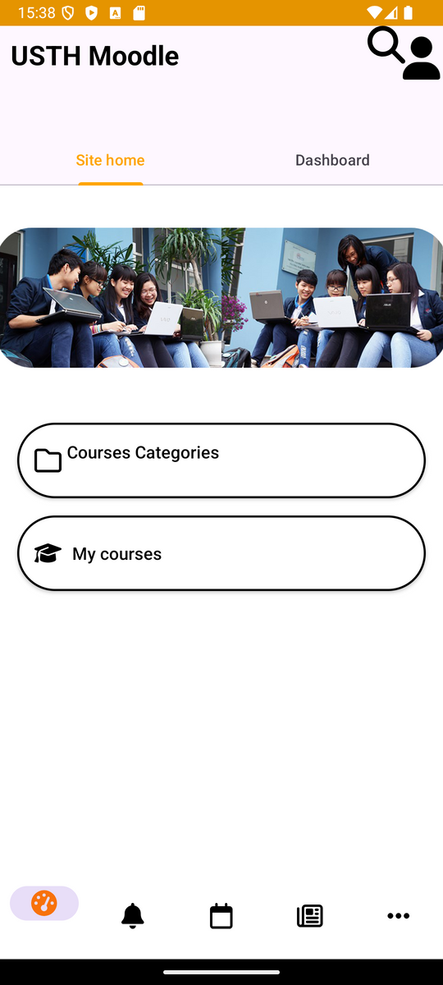
2. Architecture
3) Design principle:
follow the real Moodle app’s theme and design
maintain visual harmony and consistency

Slide 7
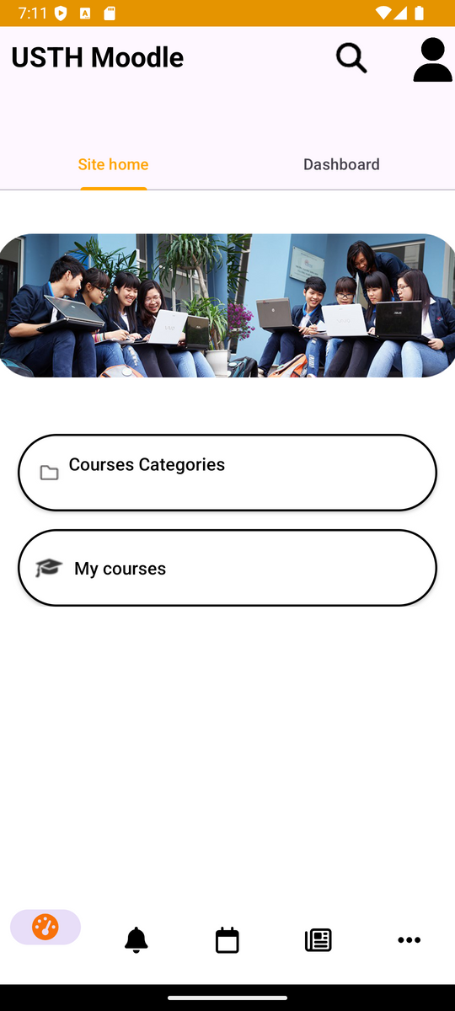
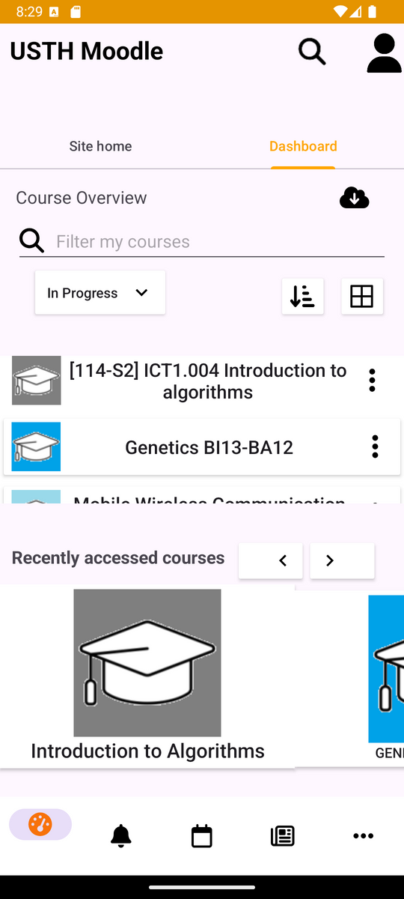
3. Activities
1) Homepage:
Site Home: Banner image with buttons for 'Course Categories' and 'My Courses.'
Dashboard: Search bar and course list for quick access

Slide 8
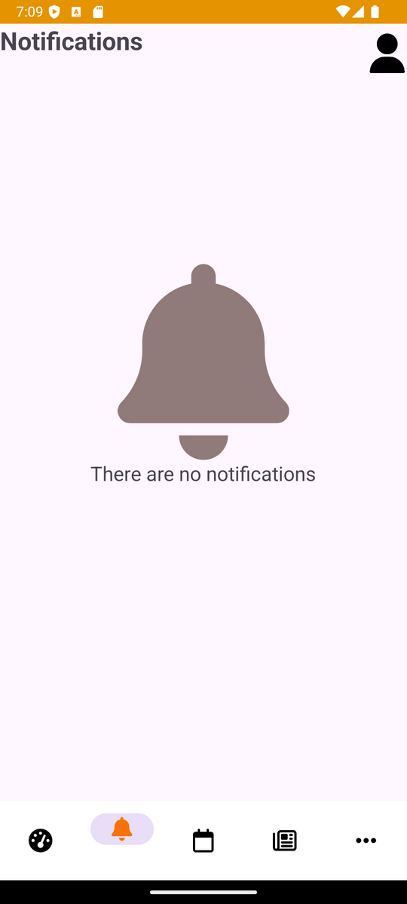
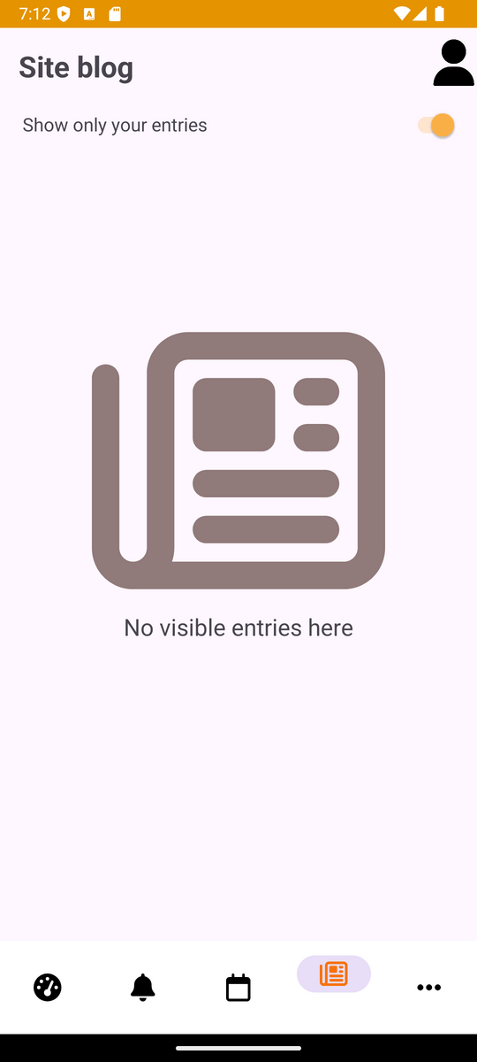
3. Activities
2) Notifications and Site blog:
Empty State Design: No current notifications or blog entries displayed.
Site Blog Button: Includes a button for managing or adding blog entries when available.

Slide 9
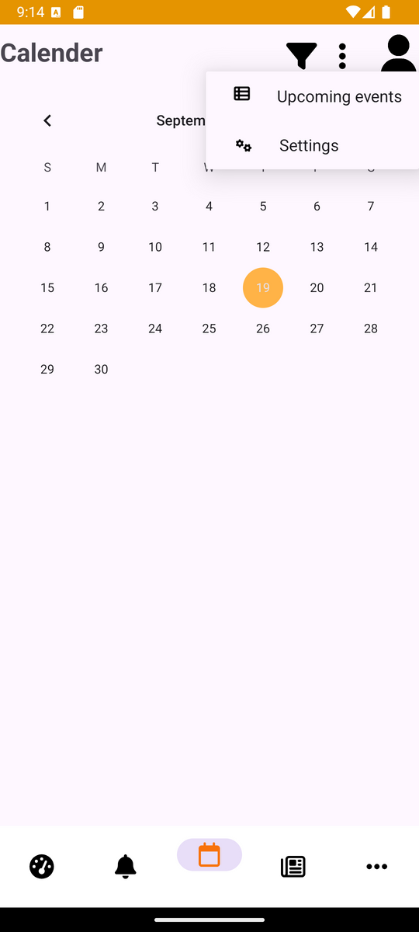
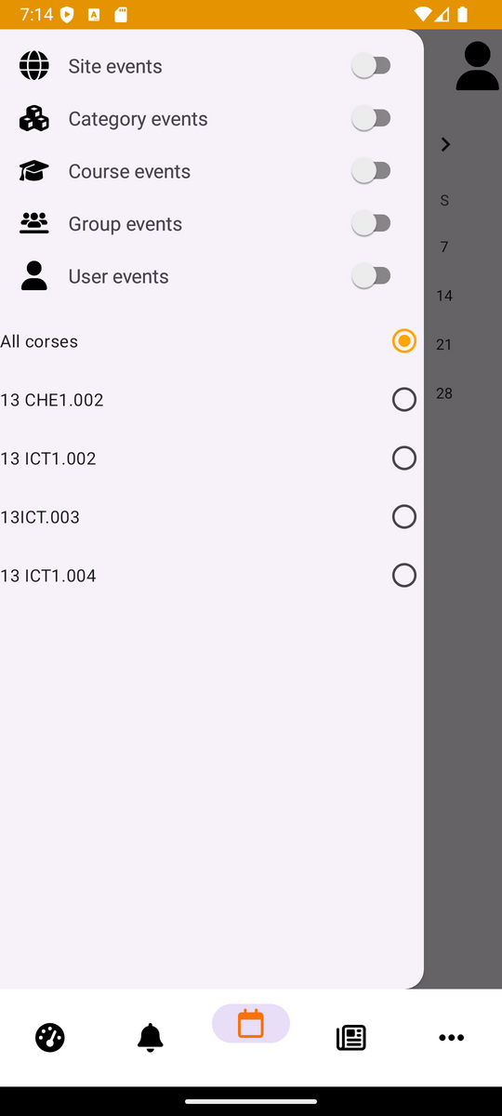
3. Activities
3) Calender:
Filter: Uses drawer layout and navigation view to sort events (site, course, group, user).
More: Popup menu for additional controls

Slide 10
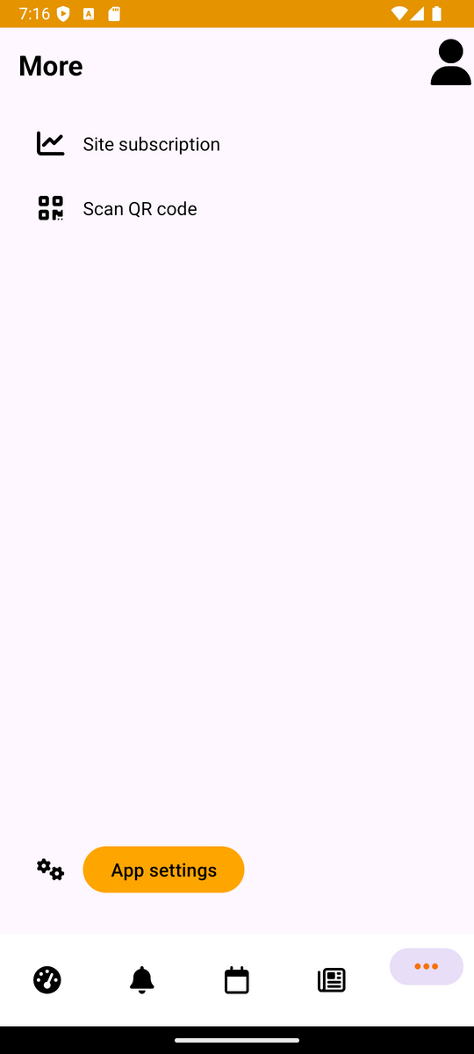
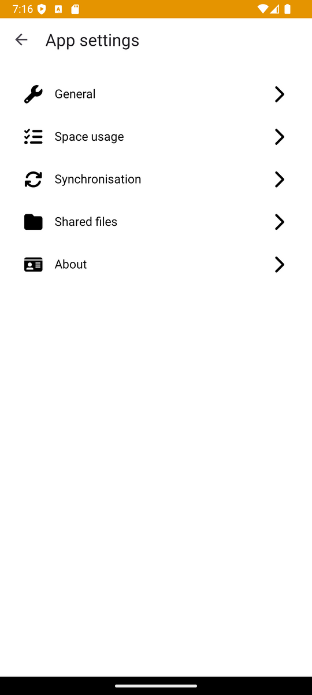
3. Activities
4) More:
Features options like "Site subscription" and "Scan QR code."
"App settings" button: include adjustments for General, Space usage, Synchronization, Shared files, and About info.

Slide 11
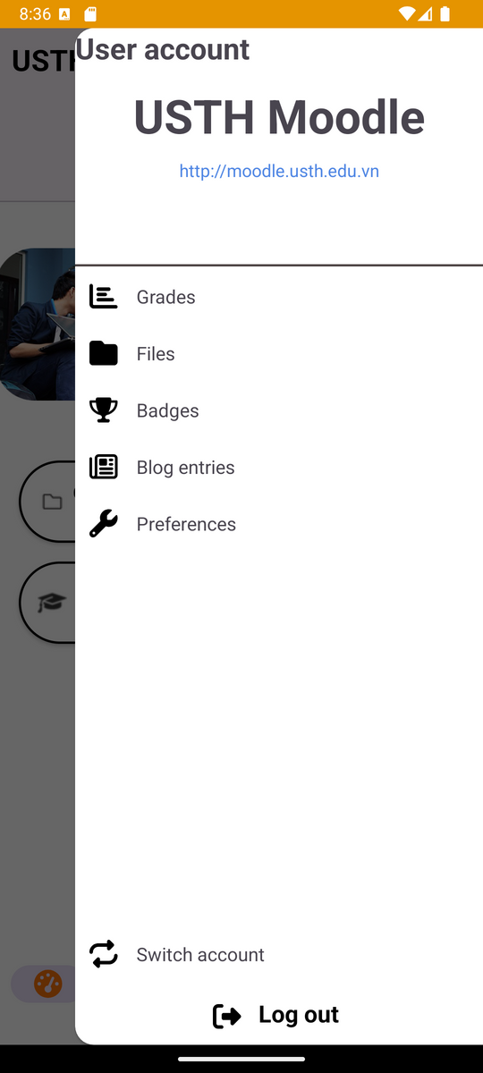
3. Activities
5) User account:
Drawer Layout: Side menu for navigation.
Navigation View: Options for Grades, Files, Badges, Blog entries, Preferences, Switch account, and Log out.

Slide 12
4. Demo

Slide 13
5. Conclusion
Demonstration of our ability to replicate UI designs
There are still lots of rooms for improvements

Slide 14
THANK YOU FOR LISTENING !

